Slide 1



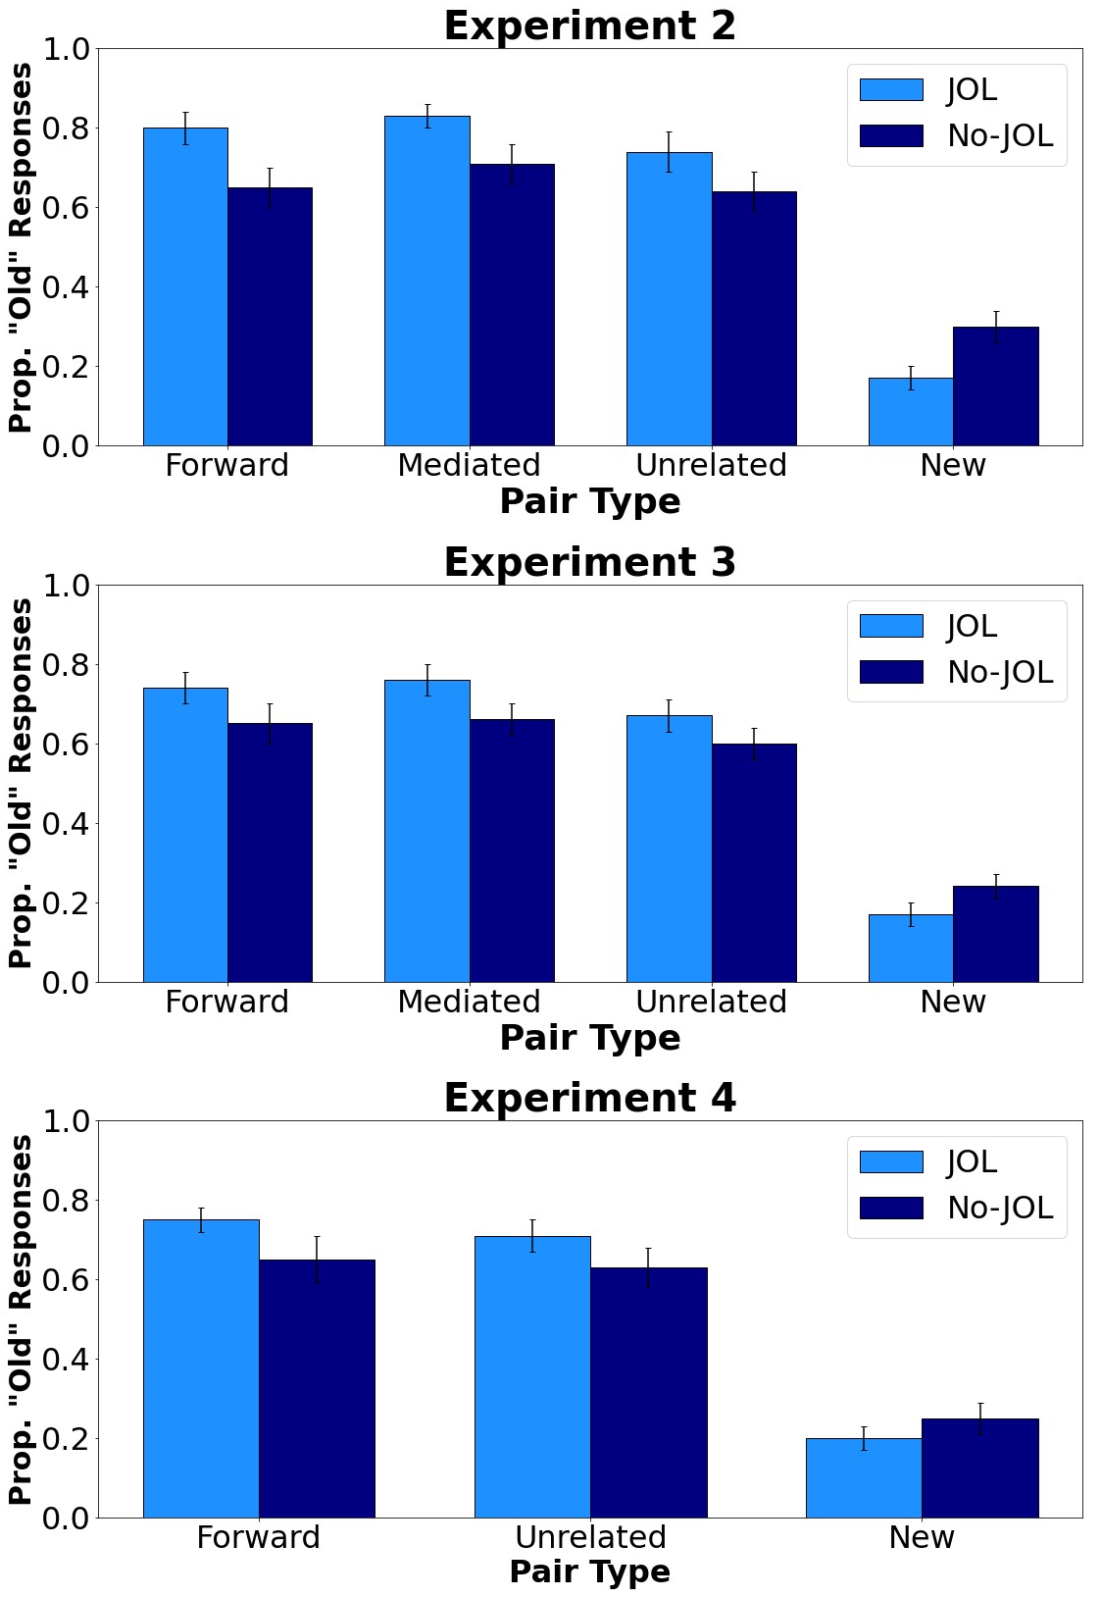
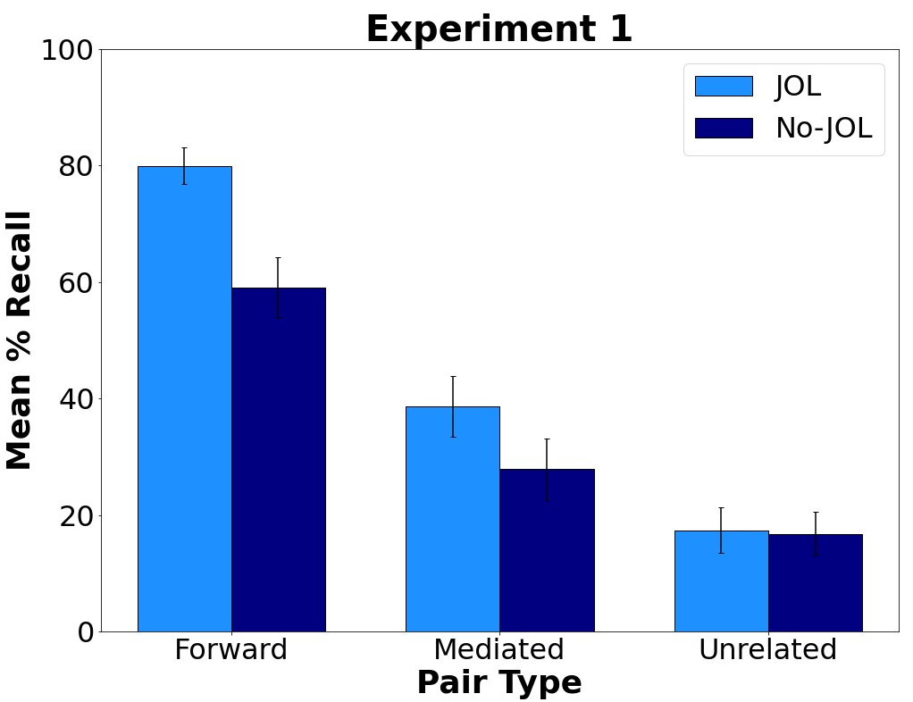
Investigating the Effects of Mediated Associations on Judgment of Learning Reactivity
Nicholas P. Maxwell, & Mark J. Huff
Introduction
General Method
Results: Recognition Testing
Previous research has consistently shown that JOLs are reactive on cue-target word pairs, such that they benefit memory for related (e.g., cat – dog) but not unrelated (e.g., cat – muffin) cue-target pairs.
To explain this pattern of positive reactivity, Soderstrom et al. (2015) proposed a cue-strengthening account, which posits that JOLs strengthen intrinsic JOL cues (e.g., relatedness) and that memory benefits occur whenever memory is tested using a method that is sensitive to these cues (e.g., cued-recall testing).
However, positive reactivity on related pairs may also reflect benefits of relational encoding, as making JOLs on cue target pairs likely encourages processing of pre-existing cue-target associations.
We tested this account by assessing whether JOLs benefit memory for mediated associates (e.g., lion – stripes). Like unrelated pairs, mediated associates contain no direct cue-target relations. However, they contain an indirect semantic relationship via a non-presented mediated (e.g., tiger).
Based on a cue-strengthening account, positive reactivity would be not be expected to occur on mediated pairs, given their lack of a direct semantic relationship. However, if JOLs also encourage the use of relational processing at encoding, mediated associates would be expected to show a memorial benefit.
By including mediated associates, the present study provides an additional test of the cue-strengthening account while also further exploring the underlying mechanisms by which JOLs improve memory.
Study
JOL vs. No-JOL
Filler
Task
Test
Cued-Recall Recognition
Bars = 95% CI
Experiment | Comparison | Test Type | n JOL | n No-JOL
1 | F vs. M vs. U | Cued-Recall | 60 | 60
2 | F vs. M vs. U | Recognition | 62 | 63
3 | F vs. M vs. U | Recognition | 61 | 62
4 | F vs. U | Recognition | 61 | 59
Note: F = Forward associates; M = Mediated associates; U = Unrelated cue-target pairs. Participants were randomly assigned to either the JOL or no-JOL encoding groups.
Results: Cued-Recall Testing
Materials
Conclusions
120 cue target word pairs were used as stimuli (40 forward associates, 40 mediated associates, and 40 unrelated cue-target pairs)
Participants studied 20 of each pair type (60 total) in Experiments 1 – 3 or 20 forward associates and 20 unrelated pairs (40 total) in Experiment 4.
Across experiments, making JOLs improved memory for related but not unrelated cue-target pairs, regardless of whether pairs were directly related or indirectly related via mediators.
This patterns suggests that JOLs specifically encourage participants to process each pair’s underlying cue-target relations. Thus, positive reactivity observed on related pairs likely reflects increased activation of cue-target associations.
Interestingly, making JOLs also improved correct recognition of unrelated cue-target pairs.
Taken together, it is likely that positive reactivity on related pairs reflects relational encoding, which is particularly effective at improving memory when testing occurs via free-recall.
However, since recognition testing is based more on familiarity cues rather than relatedness, reactivity occurs globally for all studied items, regardless of their pre-existing cue-target relations.
Ultimately, more work is needed to fully explore the link between relational processing and cue-strengthening.
Forward
Mediated
Unrelated
Mule – Donkey
Nap – Sleep
Sip – Drink
Orchid – Flower
Lion – Stripes
War – Quiet
Cry – Bottle
Tooth – Hair
Maze – Phone
King – Vase
Lease – Toil
Cash – Leg
Bars = 95% CI
Note: Pairs were equated on concreteness, length, and SUBTLEX frequency. Forward associates were additionally matched on FAS values (Nelson et al., 2004). Mediated associates were taken from Balota and Lorch (1986) and Jones (2010).
Questions? Email nicholas.maxwell@msutexas.edu.
Project info and data available at: https://osf.io/yrdsz/

